Slide 1
TypeScript

Slide 2
Session Objective
Introduction to TypeScript
Features of TypeScript
Identifiers & Variable in TypeScript
Variables in TypeScript
Class & Object in TypeScript

Slide 3
TypeScript Introduction

Slide 4
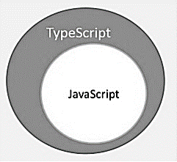
TypeScript
TypeScript is a typed superset of JavaScript that compiles to plain JavaScript.
TypeScript is pure object oriented with classes, interfaces and statically typed like C# or Java.

Slide 5
What is TypeScript?
TypeScript is JavaScript for application-scale development.
TypeScript is a strongly typed, object oriented, compiled language. It was designed by Anders Hejlsberg at Microsoft.
TypeScript is both a language and a set of tools.

Slide 6
Features of TypeScript Cont…
TypeScript is just JavaScript.
TypeScript starts with JavaScript and ends with JavaScript.
All TypeScript code is converted into its JavaScript equivalent for the purpose of execution.
TypeScript supports other JS libraries.
Compiled TypeScript can be consumed from any JavaScript code.
TypeScript-generated JavaScript can reuse all of the existing JavaScript frameworks, tools, and libraries.

Slide 7
Features of TypeScript
JavaScript is TypeScript.
This means that any valid .js file can be renamed to .ts and compiled with other TypeScript files.
TypeScript is portable.
TypeScript is portable across browsers, devices, and operating systems.
It can run on any environment that JavaScript runs on.
Unlike its counterparts, TypeScript doesn’t need a dedicated VM or a specific runtime environment to execute.

Slide 8
TypeScript Composition Cont…
A TypeScript program is composed of −
Modules
Functions
Variables
Statements and Expressions
Comments

Slide 9
TypeScript Composition
var message:string = "Hello World"
console.log(message)
On compiling, it will generate following JavaScript code.
//Generated by typescript 1.8.10
var message = "Hello World";
console.log(message);

Slide 10
Compile & Execute

Slide 11
Compile and Execute a TypeScript Cont..
Step 1
Save the file with .ts extension. For example save the file as Test.ts.
The code editor marks errors in the code, if any, while you save it.
Step 2
Right-click the TypeScript file under the Working Files option in VS Code’s Explore Pane.
Select Open in Command Prompt option.

Slide 12
Compile and Execute a TypeScript
Step 3
To compile the file use the following command on the terminal window.
tsc Test.ts
Step 4
The file is compiled to Test.js.
To run the program written, type the following in the terminal.
node Test.js

Slide 13
Variable & Identifier

Slide 14
Identifiers in TypeScript
Identifiers are names given to elements in a program like variables, functions etc.
The rules for identifiers are −
Identifiers can include both, characters and digits. However, the identifier cannot begin with a digit.
Identifiers cannot include special symbols except for underscore (_) or a dollar sign ($).

Slide 15
Identifiers in TypeScript
Identifiers cannot be keywords.
They must be unique.
Identifiers are case-sensitive.
Identifiers cannot contain spaces.

Slide 16
Variable
S.No. | Variable Declaration Syntax & Description
1. | var name:string = ”mary” The variable stores a value of type string
2. | var name:string; The variable is a string variable. The variable’s value is set to undefined by default
3. | var name = ”mary” The variable’s type is inferred from the data type of the value. Here, the variable is of the type string
4. | var name; The variable’s data type is any. Its value is set to undefined by default.

Slide 17
TypeScript Variable Scope
The scope of a variable specifies where the variable is defined. The availability of a variable within a program is determined by its scope. TypeScript variables can be of the following scopes −
Global Scope − Global variables are declared outside the programming constructs. These variables can be accessed from anywhere within your code.
Class Scope − These variables are also called fields. Fields or class variables are declared within the class but outside the methods. These variables can be accessed using the object of the class. Fields can also be static. Static fields can be accessed using the class name.
Local Scope − Local variables, as the name suggests, are declared within the constructs like methods, loops etc. Local variables are accessible only within the construct where they are declared.

Slide 18
Example of Variable scope
The following example illustrates variable scopes in TypeScript.
Example: Variable Scope
var global_num = 12 //global variable
class Numbers {
num_val = 13; //class variable
static sval = 10; //static field
storeNum():void {
var local_num = 14; //local variable
}
}
console.log("Global num: "+global_num)
console.log(Numbers.sval) //static variable
var obj = new Numbers();
console.log("Global num: "+obj.num_val)

Slide 19
Data Type

Slide 20
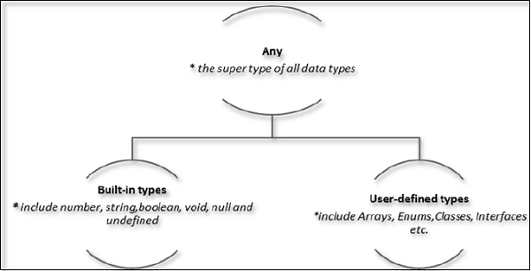
Data type classification Cont…

Slide 21
Data Type Cont…
The Any type
The any data type is the super type of all types in TypeScript.
It denotes a dynamic type.
Using the any type is equivalent to opting out of type checking for a variable.

Slide 22
Data Type Cont…
Data type Keyword Description
Number number Double precision 64-bit floating point values. It can be used to represent both, integers and fractions.
String string Represents a sequence of Unicode characters
Boolean boolean Represents logical values, true and false
Void void Used on function return types to represent non- returning functions
Null null Represents an intentional absence of an object value.
Undefined undefined Denotes value given to all uninitialized variables

Slide 23
Data Type Cont…
Null and undefined
The null and the undefined datatypes cannot be used to reference the data type of a variable.
They can only be assigned as values to a variable.
Null and undefined are not the same.
A variable initialized with undefined means that the variable has no value or object assigned to it while null means that the variable has been set to an object whose value is undefined.

Slide 24
Data Type
User-defined Types
User-defined types include Enumerations (enums), classes, interfaces, arrays, and tuple.

Slide 25
Class & Object

Slide 26
Class Cont…
Creating classes
Use the class keyword to declare a class in TypeScript. The syntax for the same is given below −
Syntax
class class_name {
//class scope
}
The class keyword is followed by the class name. The rules for identifiers must be considered while naming a class.

Slide 27
Class
A class definition can include the following −
Fields : A field is any variable declared in a class. Fields represent data pertaining to objects
Constructors : Responsible for allocating memory for the objects of the class
Functions : Functions represent actions an object can take. They are also at times referred to as methods
These components put together are termed as the data members of the class.
Consider a class Person in typescript.
class Person {
}

Slide 28
Object
An object is an instance which contains set of key value pairs. The values can be scalar values or functions or even array of other objects. The syntax is given below −
Syntax
var object_name = {
key1: “value1”, //scalar value
key2: “value”,
key3: function() {
//functions
},
key4:[“content1”, “content2”] //collection
};

